Slide 1


JEFF RUDDLE
UKAS - STRATEGIC DEVELOPMENT DIRECTOR
ROELAND NIEUWEBOER
RVA - CHAIRMAN
Digitalisation: Impact on Accreditation

Slide 2

Session Aims
To prompt the Accreditation community to think about potential impacts and the actions that may need to be taken
Notes:
This presentation is not about providing answers it is about sparking thoughts that lead to question and debate. The only answer really to give at this time is that Digitisation will and has already impact upon accreditation and the conformity assessment bodies we accredit
Hopefully this presentation will provide a platform to initiate discussions which need to happen within the accreditation community

Slide 3

Transformation vs Evolution
Digital Transformation
  Integration of digital technology in all areas of the business
  Fundamental change to business operations and delivery of value
  Introduce technology to solve existing day to day issues
  Apply data from that technology to:
    Direct strategy
    Maximise performance
    Deliver value to customers and stakeholders
Digital Evolution
Notes:
Digital Transformation is the ‘Buzz’ phrase being used at the moment, but what many businesses are doing currently is more what is being termed as ‘Digital Evolution’ that being the introduction of technology to solve existing business issues and the use of data to Direct Strategy, maximize performance and delivery value.
Digital transformation is about using technology and data to fundamentally change how your service is delivered or product is produced and therefore change how value is delivered.
Currently UKAS is very much in the Digital Evolution Phase, but what I think we should discuss today is how and why we may go about digital transformation in the coming years.

Slide 4

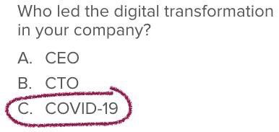
Impact of COVID-19
Notes:
Most of us will have seen this joke doing the rounds on social media. But is it true for accreditation bodies? Given what we’ve just said about what digital transformation is or even what digital evolution is?
Yes, we’ve all got good at delivering assessments remotely, Teams, Zoom, Drop Box, Sharepoint we are all now very web meeting and file sharing savvy. And we’ve been busy congratulating ourselves and slapping ourselves on the back about the great job we’ve done and how agile we area (despite the fact that it only took a global pandemic to make us change) But have we really changed anything?? Our assessments are pretty much eth same as they were before, experts observing operations at a CAB reviewing documentation and making professional judgements based on their observations we haven’t actually changed anything about the service we deliver.
What has been our approach during COVID-19
Mainly remote – coming back to do some work on site recently as some activities cannot be assessed remotely
What about other Abs what have they been doing
COVID-19 has accelerated the adoption of remote assessment within the accreditation sectors – but is this a universally good thing?
Overall on-site assessment is a more effective tool than remote assessment, however is remote assessment good enough? Currently from what we are seeing the answer is in many cases yes! The pandemic has allowed us to adopt these practices and got us through the change resistance that we would normally see in a traditionally risk adverse industry. There are many attractions to remote assessments:
- Flexibility
- Reduced impact on the customer
- Reduced environmental impact
Reduced travel time for assessors (Work/Life Balance + options on resources)
But there are downsides, inability to progress new work as easily, technical witnessing being limited, issues with team interaction, external assessor and customer IT challenges.

Slide 5

What is driving the changes we see with digitalisation?
Notes:
Data is what is driving these changes, there is a lot more data available about how processes are being performed, equipment calibrated, products tested, etc… This data is potentially very useful to us as Accreditation bodies if we can access and use this data it can support our assessments, in fact it could fundamentally change our assessments, it can move some aspects from being done periodically to being done continuously… that doe raise some challenges though

Slide 6



Making best use of data
Notes:
If we are going to use lots of data to support our assessments we need to ask ourselves:
How will we access it
How will we be sure its not been manipulated
How will we process the significant volumes of it
There is also a 4th question
How do we ensure security

Slide 7

Data Security
Notes:
Data Security will become an even bigger issue for us all, currently we have all been looking at our data security as a result of GDPR and their like. But if we take this approach we become a central point of access to information regarding all of our customers, potentially we go from relative obscurity in which we are not a target as no one really know about us or cares what data we hold, to a target. Although it could be argued what data do we have that is of interest to hackers? We are not large businesses that they can hold to ransom or don’t have data that can directly be used to obtain money (e.g. banks)

Slide 8
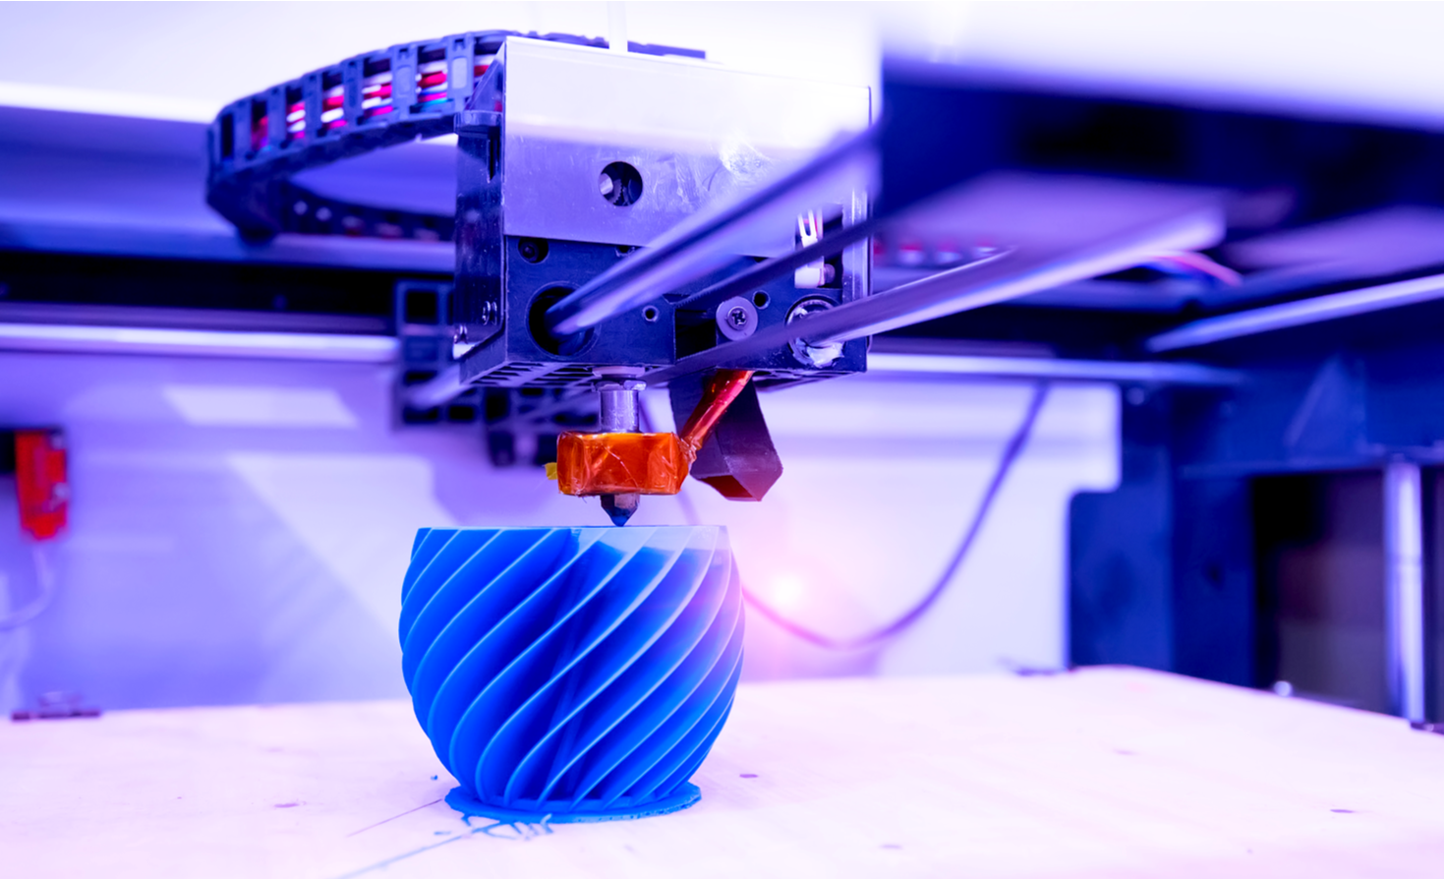
Changes to Conformity Assessment
Notes:
Obviously it will not just be Accreditation Bodies that will benefit and use these new technologies, our CABs can and already are using them. This can benefit our assessments allowing us to utilise the data from these technologies to conduct our assessments and IoT open up the possibility of continuous assessment. However, it will challenge us around the skills our assessors need and possibly the assessors that we need, this may also challenge our traditional views on assessors expertise. Are the assessors for this type of technology traditionally 50-60 years old with many years in the sector?

Slide 9

Risks, Challenges and Opportunities
Notes:
These new technologies open up many risks and opportunities for accreditation bodies, both in the way that we operate and the way that our customers will operate which will challenge our traditional views on how assessments are conducted. Next few slides will take a look at some, but probably not all of them.

Slide 10




Risks & Challenges
Notes:
There are several risks in this new approach
Virtual businesses – challenge the assumptions many of the standards are based on about how businesses work
Speed of change –its taken a pandemic for most of us to change and adopt to remote assessing – but what will make us change to deal with the technology challenge
Employee Skills – can we upskill assessors or do we need a new breed of assessors
Data security (as already mentioned)
Information overload – especially exacerbated by the assessors who are greedy for information – need to understand how we can best use all of the information that will be available
Overall, to me these point to a need for us to engage with the sector. We need to ensure we are part of their embryonic discussions on how to assure quality and ensure confidence in this technology. And we need their skills and knowledge to allow us to effectively conduct assessments of CABs using this tech.

Slide 11




Opportunities
Notes:
Whilst there are risk and challenges, it is worth remembering that there are many Opportunities for us as ABs with this tech, both in using it ourselves and coming from the fact that CABs will start to use it
Using data to support our decision making – helping us arrive at decisions to grant, maintain or renew accreditation
Being able to perform continuous assessment (although we need to avoid becoming an inspection body)
Using data from our assessments to be able to determine a better more bespoke assessment approach
Using AI to support our processes and assessment, beyond just the reviewing of large volumes of data. Could AI’s assess management systems and highlight areas of concern?

Slide 12
ROELAND NIEUWEBOER
RVA - CHAIRMAN
JEFF RUDDLE
UKAS - STRATEGIC DEVELOPMENT DIRECTOR
Discussion Thoughts

Slide 13
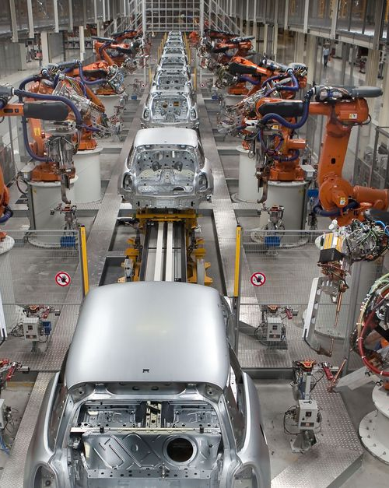
Strategy: are we prepared?
Do we link digital transformation with the wider impact of the 4th Industrial Revolution or are we too conservative?

Slide 14

Giving confidence
NABs are obliged to find other ways in the near future in creating trust because we can not rely on our current way of working.

Slide 15
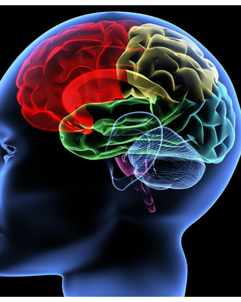
Knowledge: speeding up
NABs need to adapt to be part of and contribute to new community knowledge based environments.

Slide 16

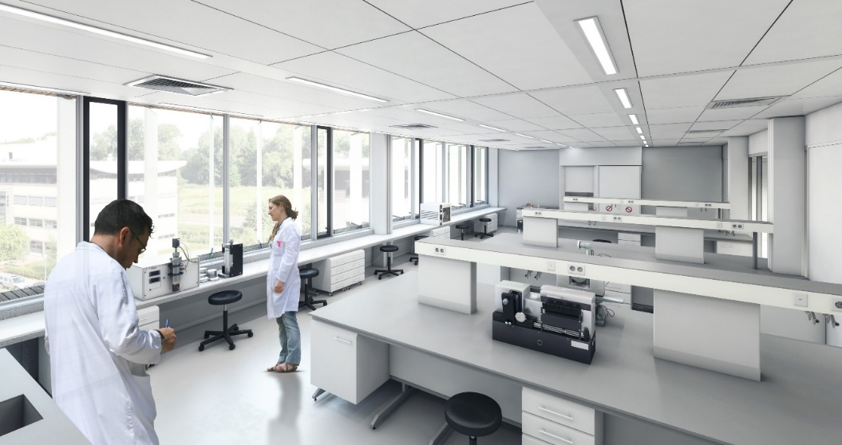
New organisational structures
Organisational structures and ways of operating are changing, do conformity assessment standards fit these new organisations?

Slide 17

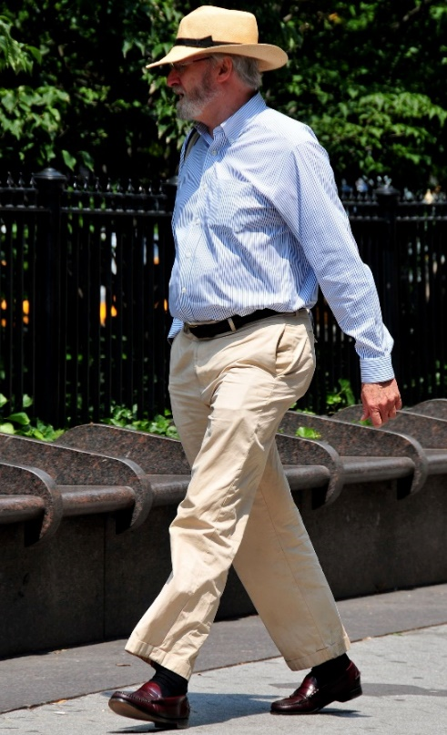
Human resources
NABs views on staffing require a major change. Who are the experts on technologies driving the 4th Industrial Revolution?

Slide 18

Attractive employer
To be a competitive employer the NAB needs a high-end technology and data driven process and environment.

Slide 19

Authority at stake: confidentiality
For NABs the challenge to keep information confidential is a growing problem due to an overload of data and information.

Slide 20
ROELAND NIEUWEBOER
RVA - CHAIRMAN
JEFF RUDDLE
UKAS - STRATEGIC DEVELOPMENT DIRECTOR
Thank You

